Slide 1
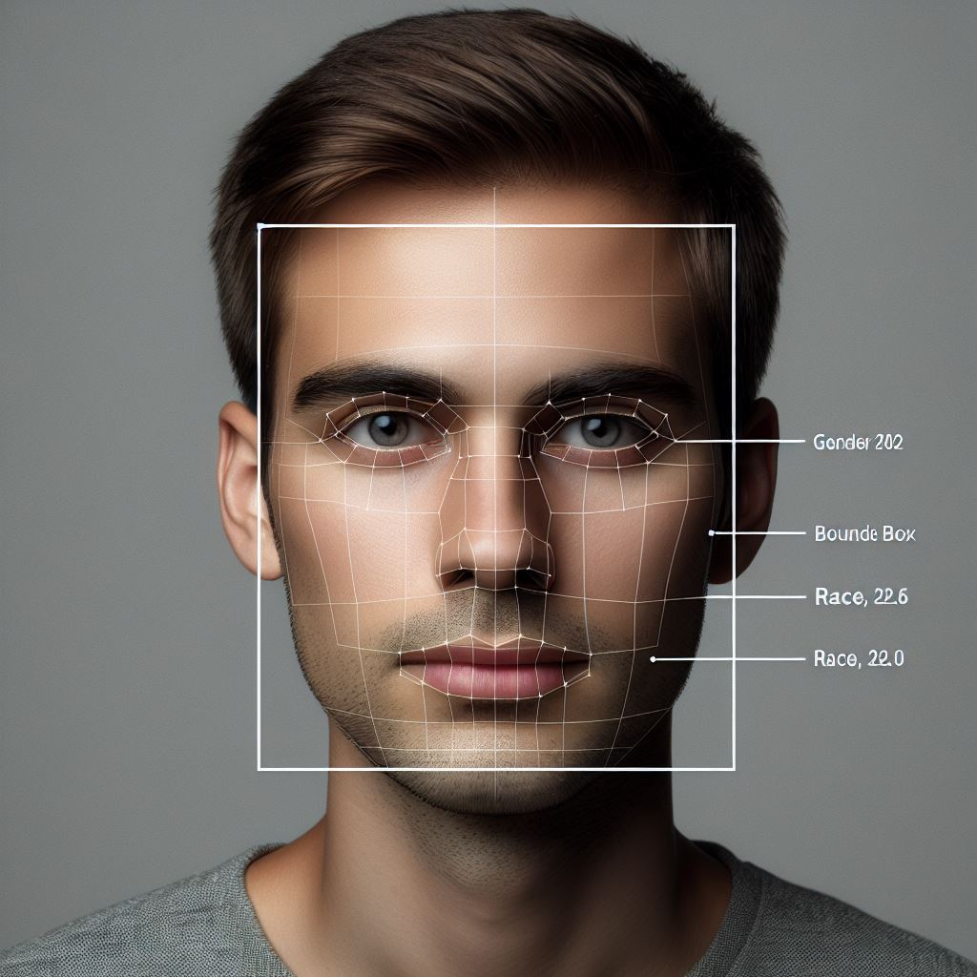
Enhanced ATM Security: Facial Analysis for Profile Monitoring and Alerting
Prepared by Pius Yee (DSI-SG-42)

Slide 2
Introduction
Automated Teller Machines (ATMs) have become an essential part of our daily lives
However, the physical cards and PINs exposes to risk of ATM skimming
ATM skimming is a type of card fraud.
It’s a way of stealing PINs and information of ATM cards by rigging machines with hidden recording devices.

Slide 3
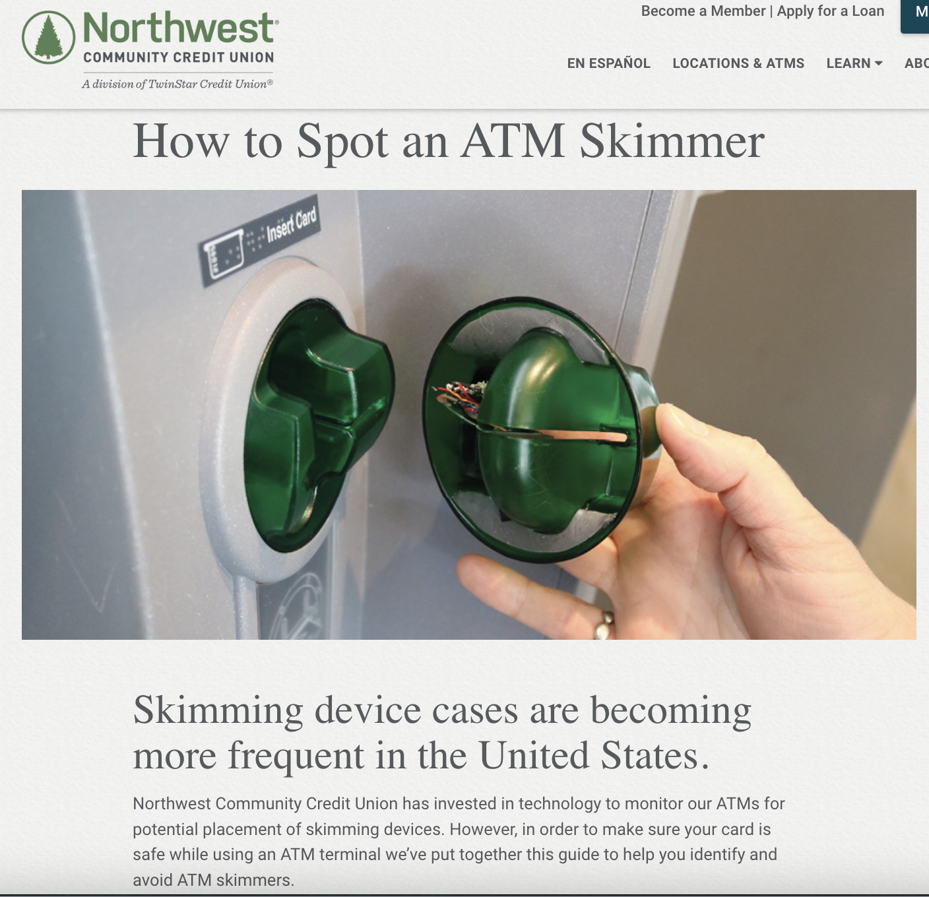
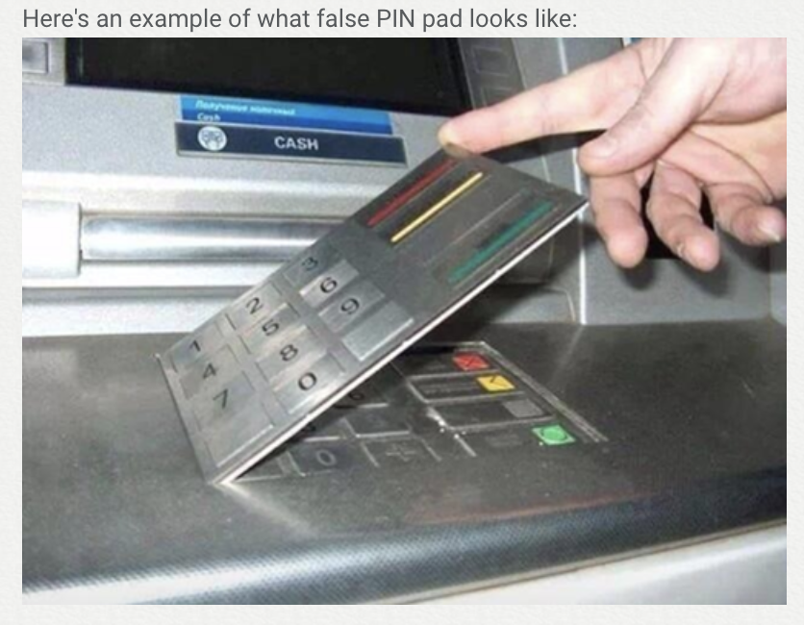
False PIN pad
Card slot
Source: https://www.nwcu.com/learn/how-spot-atm-skimmer

Slide 4
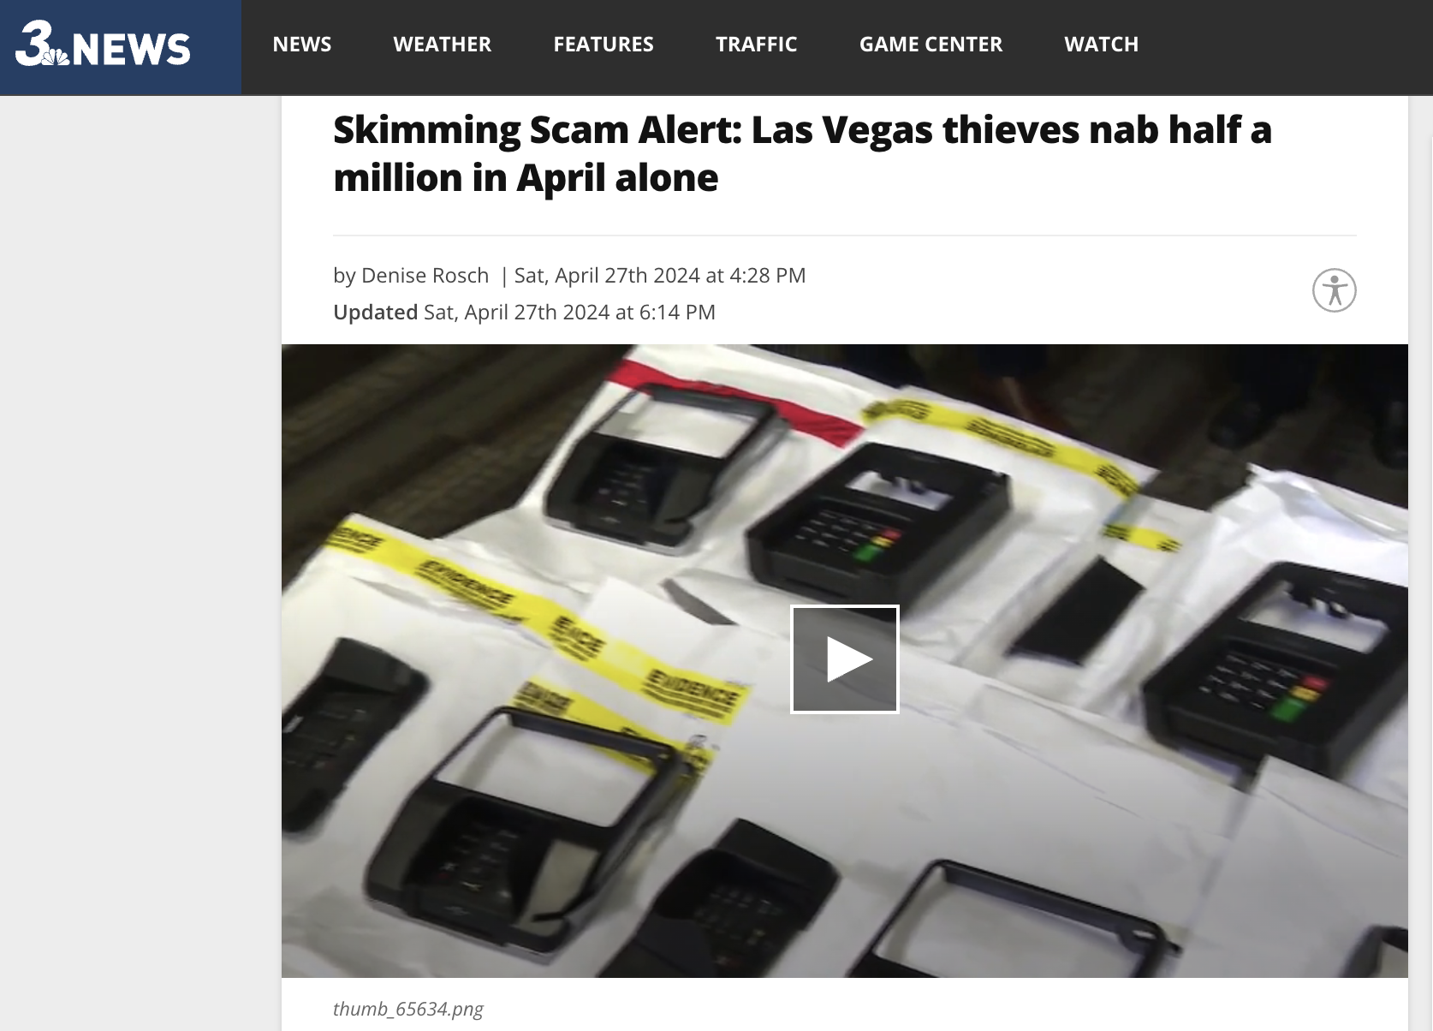
Rising cases of ATM skimming even in year 2024!
Source: https://news3lv.com/news/local/skimming-scam-alert-las-vegas-thieves-nab-half-a-million-in-april-alone

Slide 5

Persona
Sarah relies on ATMs for quick cash access but expects a secure and efficient experience.
With the rise of ATM skimming scams, she worries that using an ATM might expose her card details and PIN.
She feels particularly unsafe when using ATMs in isolated locations, where the risk of skimming might be higher.

Slide 6
Problem Statement
Existing security measures might not be sufficient to identify and prevent fraudulent withdrawal. Therefore, we need a system that leverages existing ATM infrastructure to introduce an additional layer of security.
How can we utilize profiling using computer vision to provide additional security for bank customers?

Slide 7
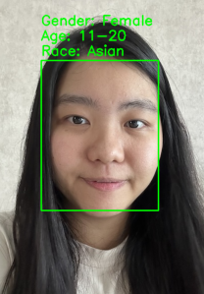
How does it work?
Analyze
Analyze video footage captured by ATM cameras
Detect
Detect the age, gender, and race of the ATM user
Compare
Compare with the cardholder’s profile
Identify
Identify discrepancies that might be suspicious
Trigger
Trigger real-time alerts to the cardholder or bank
Notes:
Current situation vs my proposed idea

Slide 8
Machine learning models
Face Detection model
Gender classification model
Race classification model
Age classification model
8
Notes:
classification

Slide 9
Data collection and pre-processing

Slide 10
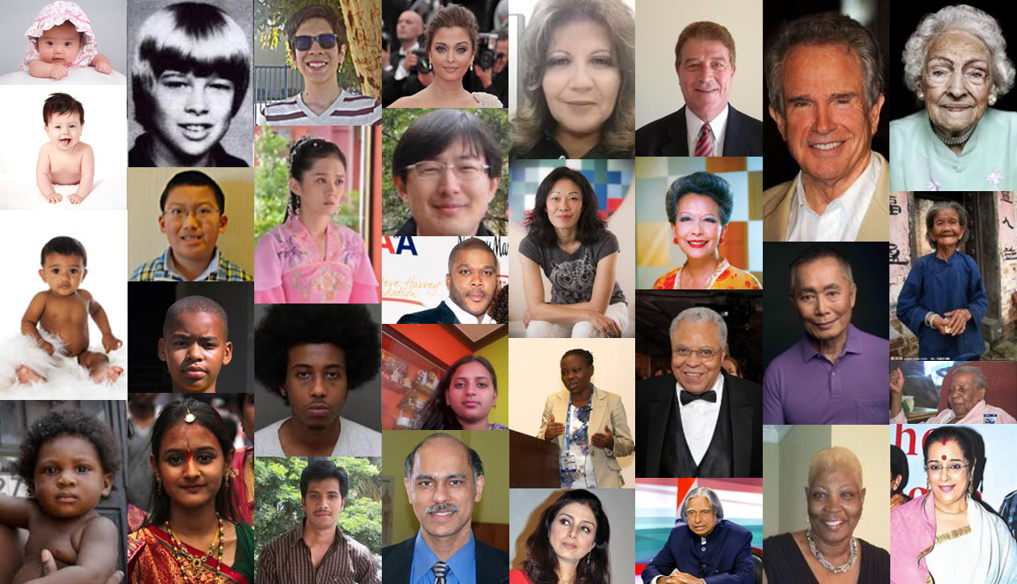
Dataset used
UTKFace
The raw data utilized for this project is the UTKFace dataset.
It is a large-scale face dataset encompassing a wide age range, from 0 to 116 years old.
The dataset comprises over 23,000 face images annotated with
Gender
Race
Age

Slide 11
Augmentation on training datasets
Augmentation types | Value | Description
Width shift | 20% | Randomly shifts the image horizontally along the width by up to 20% of the total width, enhancing model robustness to object position variations.
Height shift | 20% | Randomly shifts the image vertically along the height by up to 20% of the total height, similar to the width shift but in the vertical direction.
Shear | 20% | Applies a shear transformation, slanting the image along one axis, helping simulate perspective changes.
Zoom | 20% | Randomly zooms the image in or out by up to 20%, making the model more resilient to changes in the object's apparent size.
Horizontal flip | NA | Randomly flips the image horizontally (like looking in a mirror), helping prevent the model from developing biases based on left/right orientation.

Slide 12


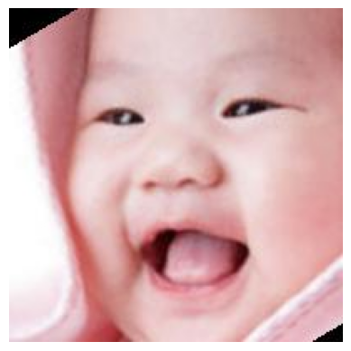

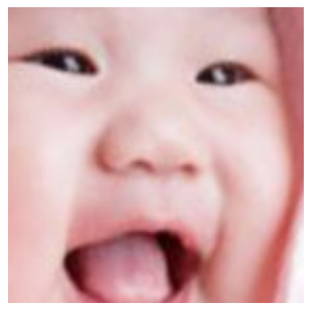
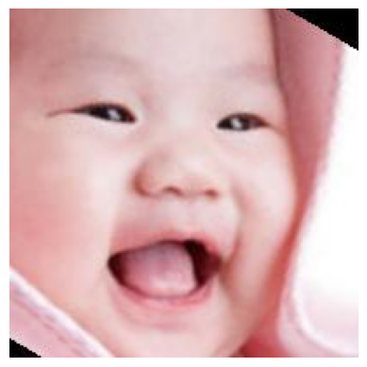
Augmentation on training datasets
Original
Horizontal flip
Height shift
Width shift
Zoom
Shear

Slide 13
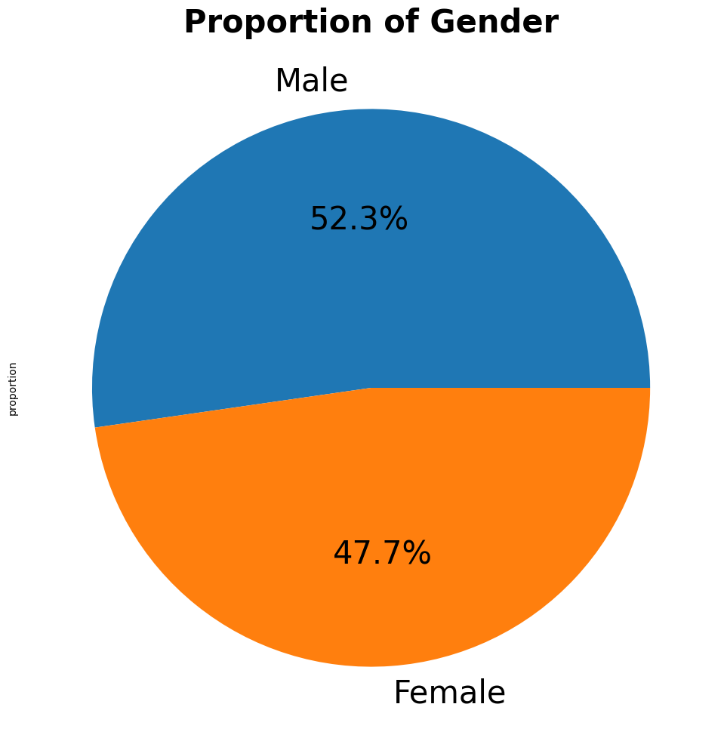
Gender proportion in UTKFace
The proportion of Male and female is balanced

Slide 14
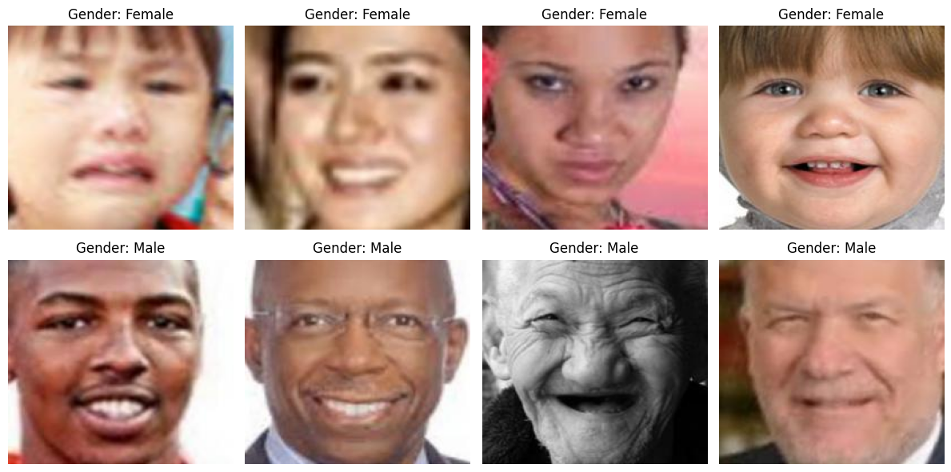
Gender
Some examples of Male and Female datasets:

Slide 15
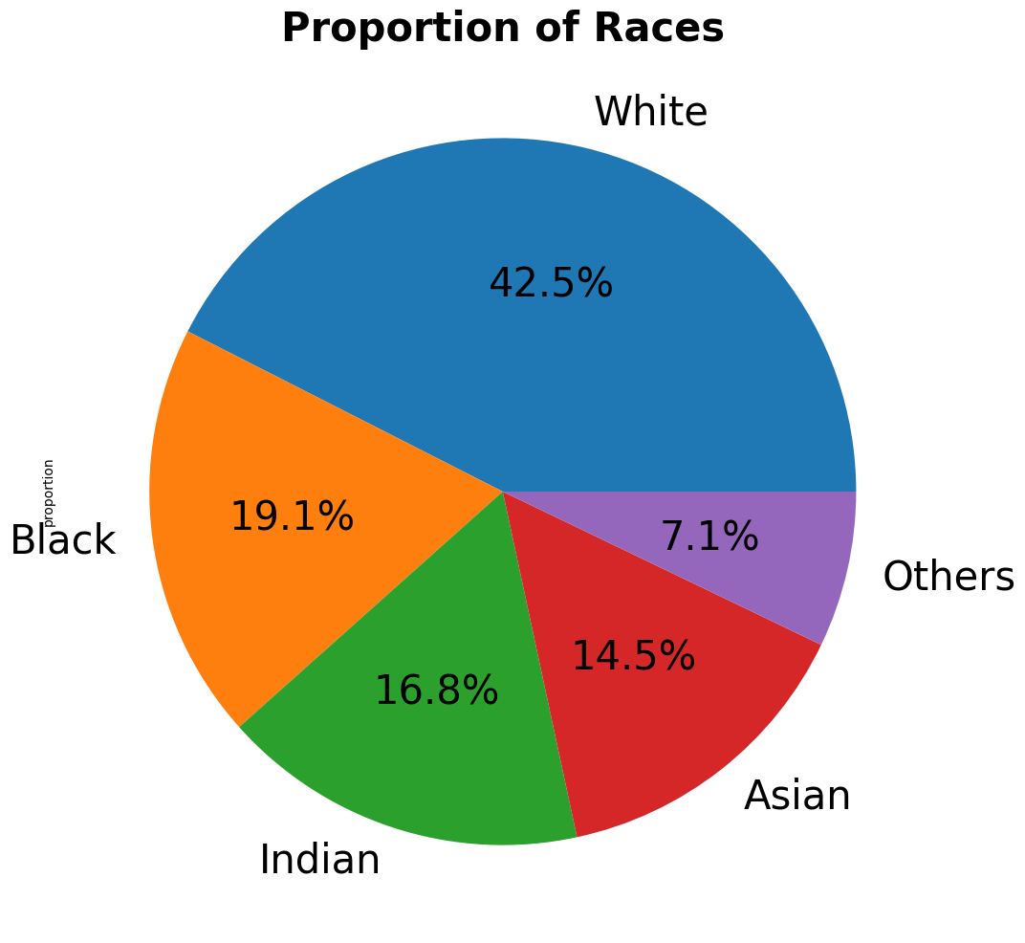
Race proportion in UTKFace
White has the highest proportion in the dataset, followed by Black, Indian, Asian and Others.

Slide 16
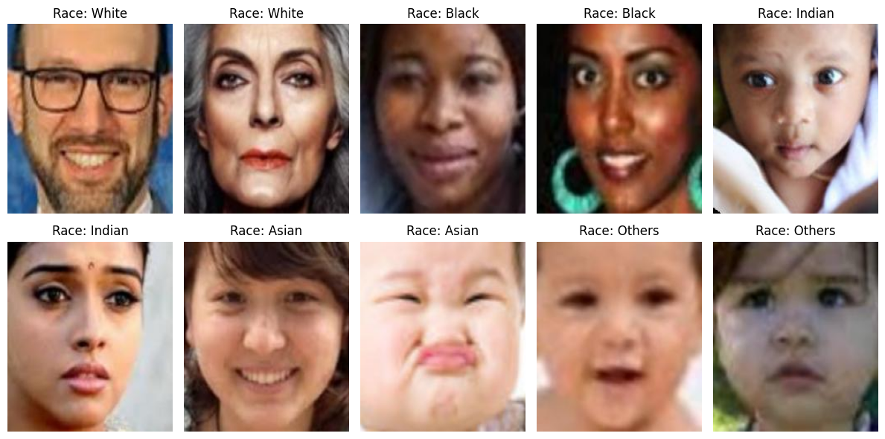
Race
Some examples of racial datasets:

Slide 17
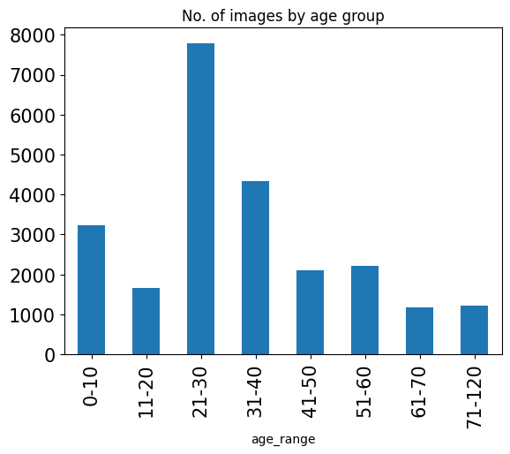
Age proportion in UTKFace
Age group ‘21-30’ has the highest proportion

Slide 18
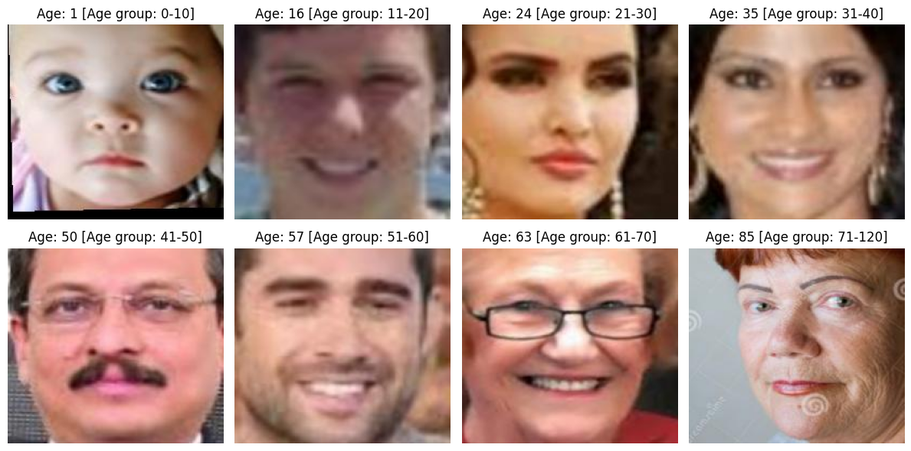
Age
Some examples of age datasets:

Slide 19
Modelling

Slide 20
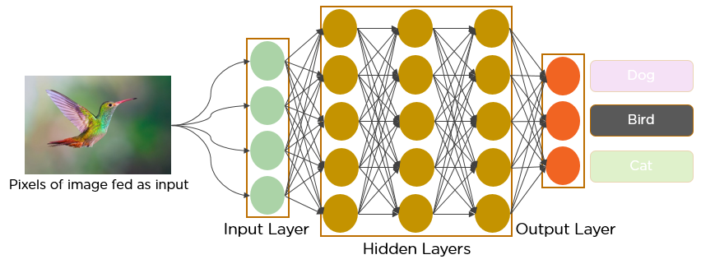
CNN (Convolutional Neural Networks)
Neural networks are like our brains, learning to find patterns in data.
CNNs are special neural networks that excel at analyzing images. Think of them as image detectives with special magnifying glasses that look for shapes, colors, and patterns.
Image from: https://www.analyticsvidhya.com/blog/2021/05/convolutional-neural-networks-cnn/
20

Slide 21
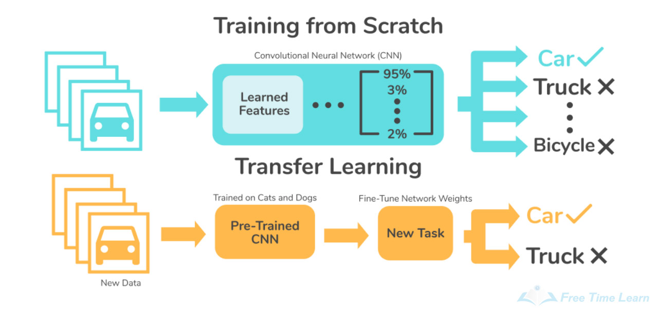
Transfer learning of pre-trained model
Transfer learning leverages a pre-trained model, using its learned features (weights) as a starting point, and fine-tuning it for the specific task with less data.
Image from: https://skyengine.ai/se/skyengine-blog/128-what-is-transfer-learning
21

Slide 22
Machine learning models
Face Detection model
Gender classification model
Race classification model
Age classification model
22
Notes:
classification

Slide 23
Modelling process
Final model
The best base model
CNN (Convolutional Neural Network)
Output
Hyperparameter tuning
Base models
VGGFace
(Pre-trained)
ResNet
(Pre-trained)
23

Slide 24
Base models
Gender
Base models
Race
Age
Model | Train Accuracy | Test Accuracy
CNN | 0.7356 | 0.7687
VGGFace | 0.9132 | 0.9264
ResNet 50 | 0.5233 | 0.5294
CNN (Convolutional Neural Network)
VGGFace
(Pre-trained)
ResNet
(Pre-trained)
24

Slide 25
Base models
Gender
Base models
Race
Age
Model | Train Accuracy | Test Accuracy
CNN | 0.7356 | 0.7687
VGGFace | 0.9132 | 0.9264
ResNet 50 | 0.5233 | 0.5294
CNN (Convolutional Neural Network)
VGGFace
(Pre-trained)
ResNet
(Pre-trained)
VGGFace is the best!
25

Slide 26
Base models
Race
Base models
Gender
Age
Model | Train Accuracy | Test Accuracy
CNN | 0.3141 | 0.2262
VGGFace | 0.7993 | 0.8043
ResNet 50 | 0.3211 | 0.2895
CNN (Convolutional Neural Network)
VGGFace
(Pre-trained)
ResNet
(Pre-trained)
26

Slide 27
Base models
Race
Base models
Gender
Age
Model | Train Accuracy | Test Accuracy
CNN | 0.3141 | 0.2262
VGGFace | 0.7993 | 0.8043
ResNet 50 | 0.3211 | 0.2895
CNN (Convolutional Neural Network)
VGGFace
(Pre-trained)
ResNet
(Pre-trained)
VGGFace is the best!
27

Slide 28
Base models
Age
Base models
Gender
Race
Model | Train Accuracy | Test Accuracy
CNN | 0.2793 | 0.3070
VGGFace | 0.5883 | 0.6096
ResNet 50 | 0.2476 | 0.3322
CNN (Convolutional Neural Network)
VGGFace
(Pre-trained)
ResNet
(Pre-trained)
28

Slide 29
Base models
Age
Base models
Gender
Race
Model | Train Accuracy | Test Accuracy
CNN | 0.2793 | 0.3070
VGGFace | 0.5883 | 0.6096
ResNet 50 | 0.2476 | 0.3322
CNN (Convolutional Neural Network)
VGGFace
(Pre-trained)
ResNet
(Pre-trained)
VGGFace is the best!
29

Slide 30
Modelling process
Gender
The best base model
CNN (Convolutional Neural Network)
Output
Hyperparameter tuning
Base models
VGGFace
(Pre-trained)
ResNet
(Pre-trained)
✅
30

Slide 31
Fine Tuning – VGGFace
Early stopping
Batch Normalization
Dropout
Model after fine-tuning

Slide 32
Hyperparameter tuning
Hyperparameter tuning
Gender
Race
Age
Model | Train Accuracy | Test Accuracy
CNN | 0.7356 | 0.7687
VGGFace | 0.9132 | 0.9264
ResNet 50 | 0.5233 | 0.5294
VGGFace (tuned) | 0.9110 | 0.9321
VGGFace
32

Slide 33
Hyperparameter tuning
Hyperparameter tuning
Gender
Race
Age
Model | Train Accuracy | Test Accuracy
CNN | 0.7356 | 0.7687
VGGFace | 0.9132 | 0.9264
ResNet 50 | 0.5233 | 0.5294
VGGFace (tuned) | 0.9110 | 0.9321
VGGFace
33

Slide 34
Hyperparameter tuning
Hyperparameter tuning
Race
Gender
Age
Model | Train Accuracy | Test Accuracy
CNN | 0.3141 | 0.2262
VGGFace | 0.7993 | 0.8043
ResNet 50 | 0.3211 | 0.2895
VGGFace (tuned) | 0.8124 | 0.8379
VGGFace
34

Slide 35
Hyperparameter tuning
Hyperparameter tuning
Race
Gender
Age
Model | Train Accuracy | Test Accuracy
CNN | 0.3141 | 0.2262
VGGFace | 0.7993 | 0.8043
ResNet 50 | 0.3211 | 0.2895
VGGFace (tuned) | 0.8124 | 0.8379
VGGFace
35

Slide 36
Hyperparameter tuning
Hyperparameter tuning
Age
Gender
Race
Model | Train Accuracy | Test Accuracy
CNN | 0.2793 | 0.3070
VGGFace | 0.5883 | 0.6096
ResNet 50 | 0.2476 | 0.3322
VGGFace (tuned) | 0.6128 | 0.6312
VGGFace
36

Slide 37
Hyperparameter tuning
Hyperparameter tuning
Age
Gender
Race
Model | Train Accuracy | Test Accuracy
CNN | 0.2793 | 0.3070
VGGFace | 0.5883 | 0.6096
ResNet 50 | 0.2476 | 0.3322
VGGFace (tuned) | 0.6128 | 0.6312
VGGFace
37

Slide 38
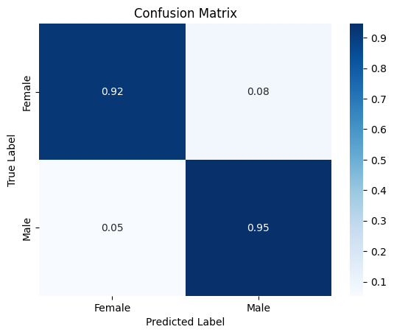
Confusion Matrix
Gender
Race
Age
*% over total True Label

Slide 39
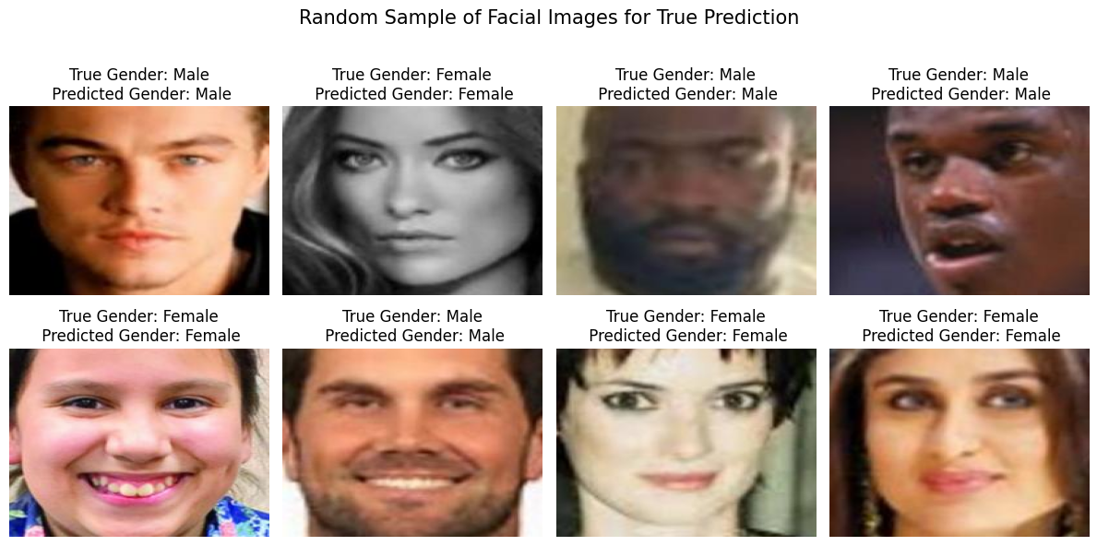
Samples of True Prediction

Slide 40
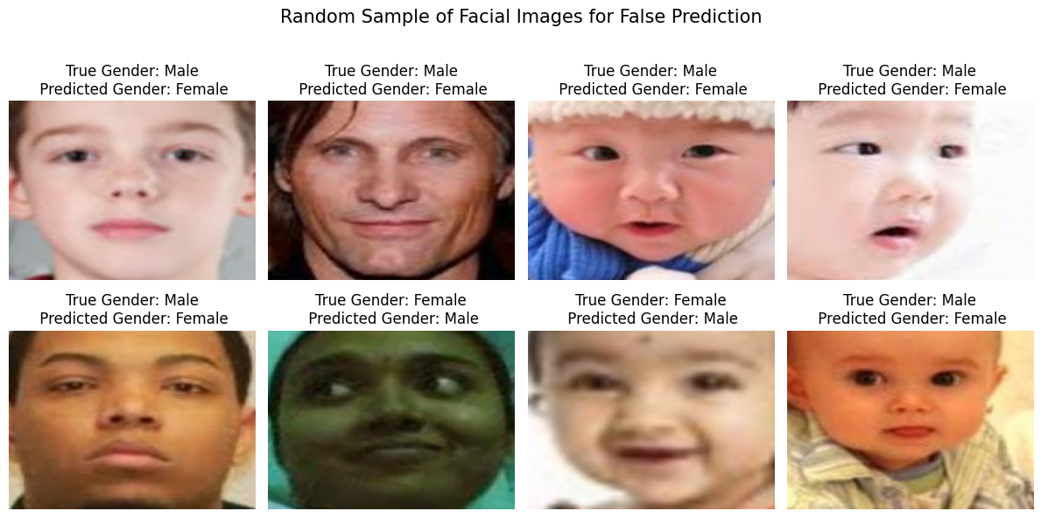
Samples of False Prediction

Slide 41
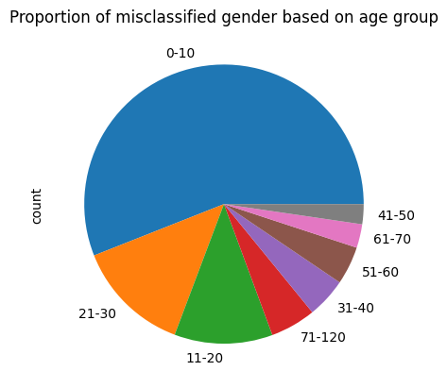
Proportion of misclassified gender based on age group

Slide 42
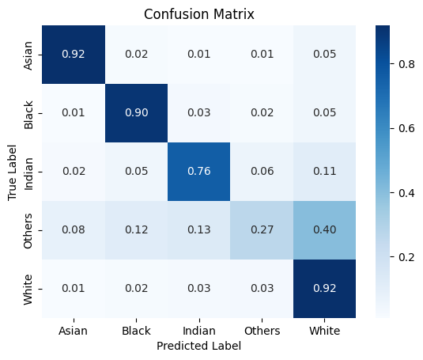
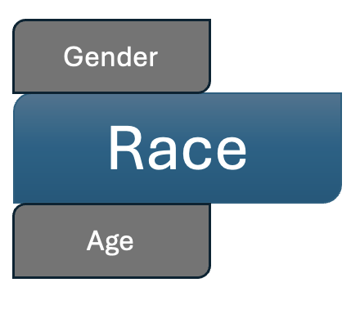
Confusion Matrix
*% over total True Label

Slide 43
Confusion Matrix
TP
*% over total True Label

Slide 44
Confusion Matrix
TP
FN
*% over total True Label

Slide 45
Confusion Matrix
TP
FN
FP
*% over total True Label

Slide 46
Confusion Matrix
TP
FN
FP
TN
*% over total True Label

Slide 47
Confusion Matrix
*% over total True Label

Slide 48
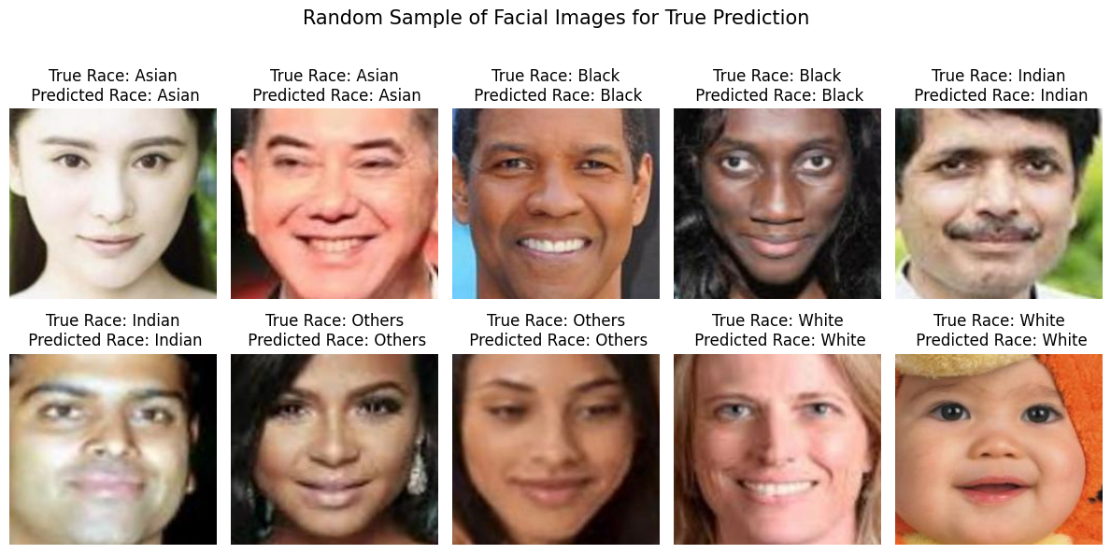
Samples of True Prediction

Slide 49
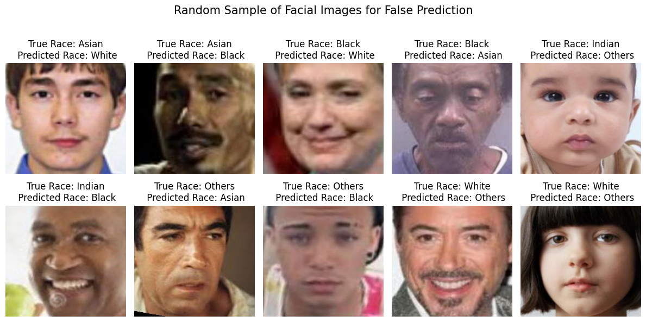
Samples of False Prediction

Slide 50
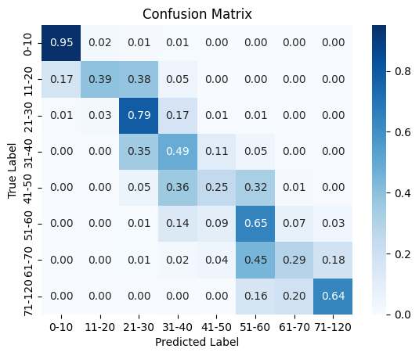
Confusion Matrix
Gender
Race
Age
*% over total True Label

Slide 51
Confusion Matrix
Gender
Race
Age
*% over total True Label

Slide 52
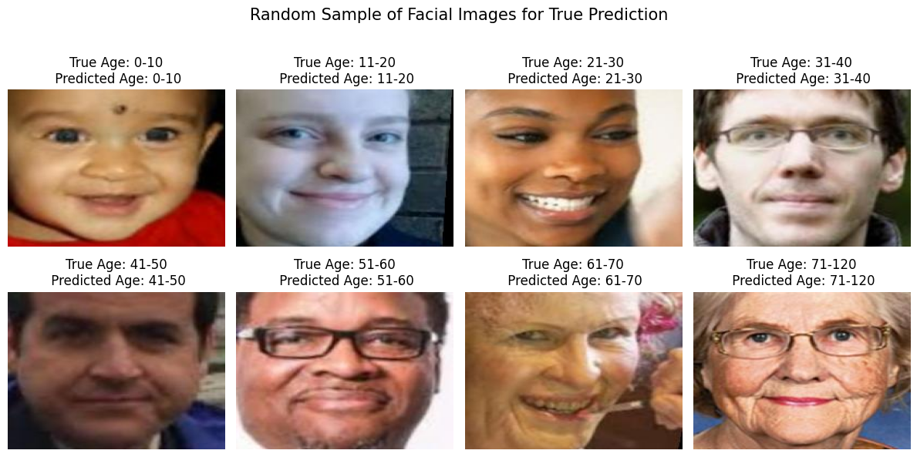
Samples of True Prediction

Slide 53
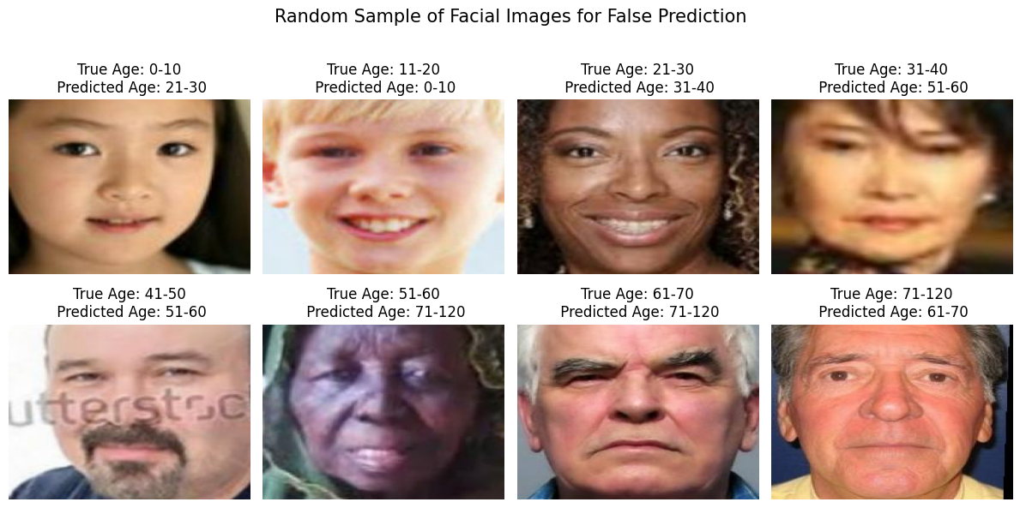
Samples of False Prediction

Slide 54
Machine learning models
Face Detection model
Gender classification model
Race classification model
Age classification model
54
Notes:
classification

Slide 55
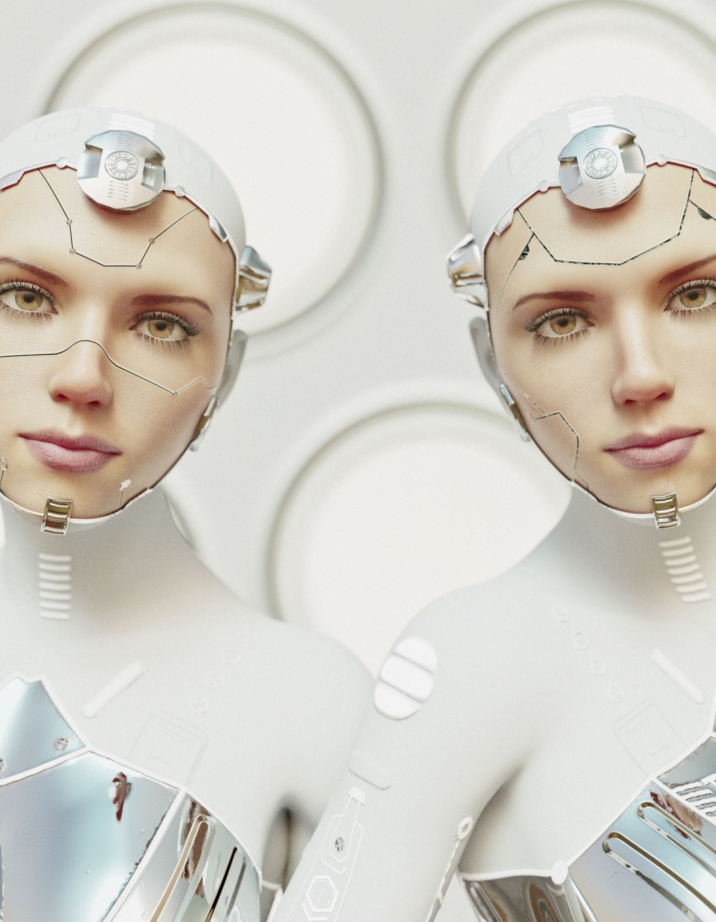
Face Detection model
MTCNN is a powerful tool for finding faces in images and videos. It's accurate, fast, and works well even in challenging conditions. This makes it a popular choice for tasks like facial recognition, image annotation, and emotion detection in videos.

Slide 56


Face Detection model
Faces
Gender
Age
Face Detection
Classification model
Output
Race
Images or videos with labelled faces
Image or video

Slide 57
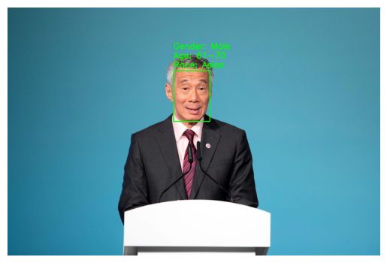
Face Detection on a single-face image

Slide 58
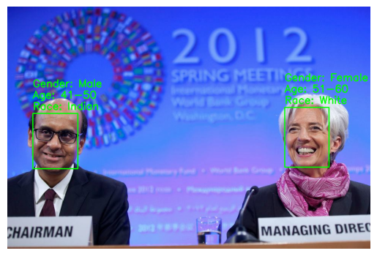
Face Detection on a multiple-faces image

Slide 59
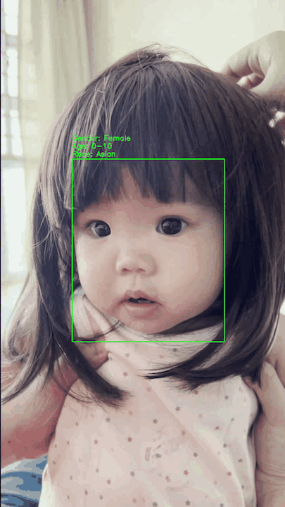
Face Detection on a single-face video

Slide 60
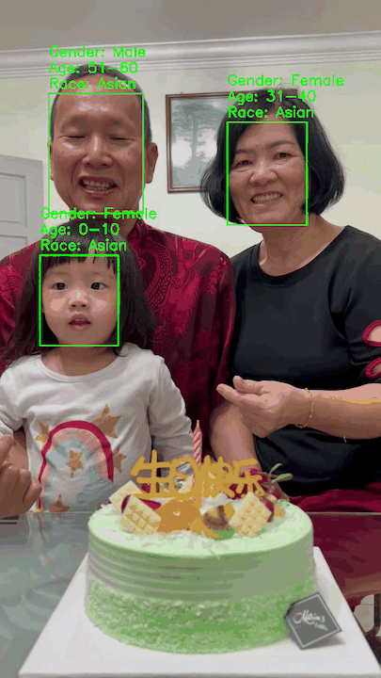
Face Detection on a multiple-faces video

Slide 61

Demo – Face detection on ATM customers

Slide 62
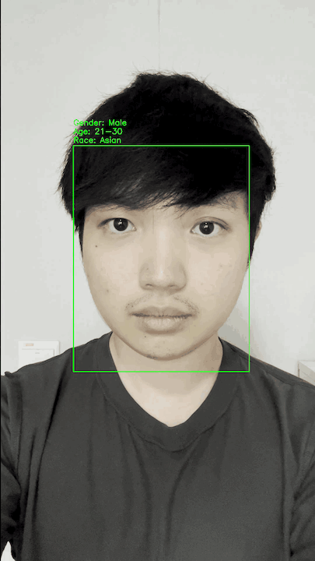
Video 1

Slide 63
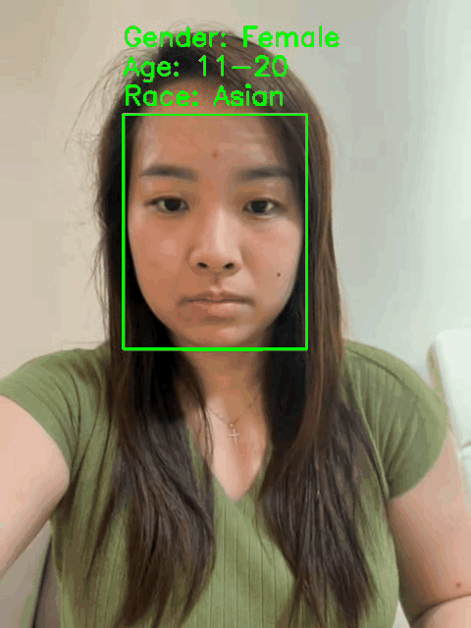
Video 2

Slide 64

Live demo

Slide 65
Machine learning models
Face Detection model
Gender classification model
Race classification model
Age classification model
65
Notes:
classification

Slide 66
Limitation of the models
Age model
The model has limited accuracy (0.63) when trying to determine age from facial features.
This is because judging age from appearance alone is difficult and subjective, as people can look much younger or older than their actual age.
👱🏻‍♂️👴🏻

Slide 67
Limitation of the models
Gender and Race model
Despite good performance in gender and race prediction, the model might be inaccurate due to limitations of facial features.
Just like age, appearance can vary significantly from a person's actual gender and race.
👨🏽👩🏻

Slide 68
Limitation of the models
Face Detection model
The model cannot detect faces with face masks on.
😷

Slide 69
What’s next?
Appearance demographic
Due to the difference between appearance and actual demographics, banks might need to store additional data about a customer's perceived appearance.
In cases like a 30-year-old customer consistently appearing like a 20-year-old, the system should adapt to recognize their "appearance age".
This solves the problem of profiles mismatching a customer's visual presentation.
Banks may consider mandatory mask removal for cash withdrawals at ATMs.
Finding additional datasets to balance the training data for age and race.
💡

Slide 70
Recap: Problem Statement
How can we utilize profiling using computer vision to provide additional security for bank customers?

Slide 71
Conclusion
The models effectively tackle the problem statement by enhancing ATM security.
The models improve ATM security by using face detection to flag suspicious withdrawals where the person doesn't match the cardholder. This builds customer trust in the bank's ATMs.
🥰🏦

Slide 72

Q&A

Slide 73

Thank you!

Slide 74

Appendix

Slide 75
Other metrics – VGGFace (fine-tuned)
 | Gender | Race | Age
Accuracy | 0.93 | 0.84 | 0.63
Precision | 0.93 | 0.83 | 0.63
Recall | 0.93 | 0.84 | 0.63
F1 Score | 0.93 | 0.84 | 0.62

Slide 76

Cost and benefit analysis

Slide 77
Costs to be incurred
Development cost
Personnel costs for data scientists and engineers.
Implementation cost
Integration into existing ATM systems
Maintenance
Regular face model updates to ensure accuracy with new data.
Computational resources for training.
Costs of installing camera or any related hardware onto ATMs

Slide 78
Benefits to be realized:
Increased customer trust
Compliance with regulations
Prevention of financial loss

